Slide 1

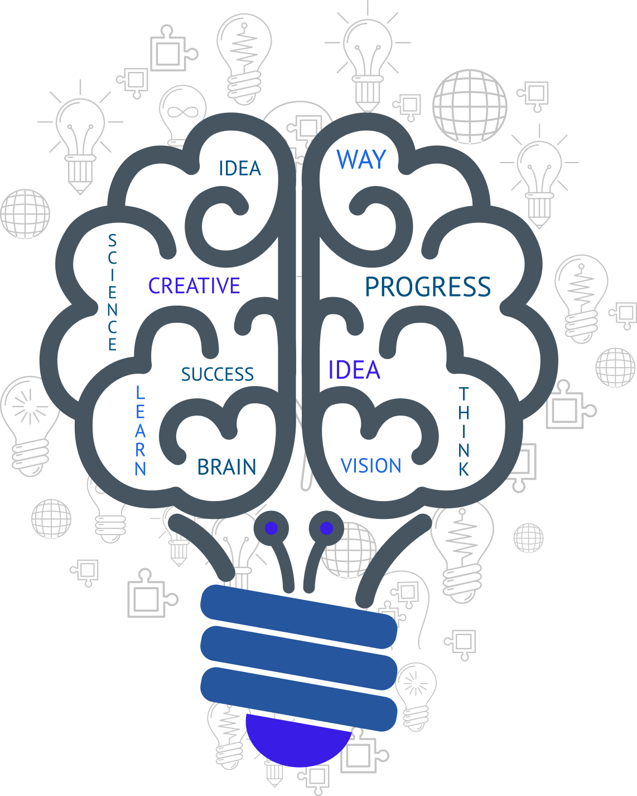
- UX Design Case
by Sofia Kasimi
Hoevelaken / Netherlands - 26/03/2019

Slide 2

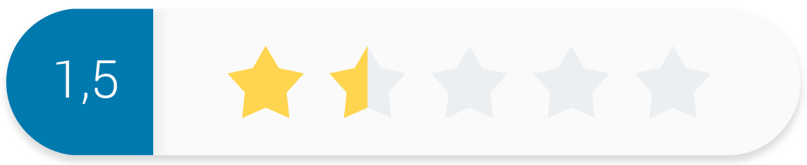
Research / Define
I have been asked to develop one of the following scenarios:
Enable more effective processing of receipts and invoices.
Improving direct communication with Ben.
Show the added value of renewed proposition of accounting firm
Lighthouse Accounting to customer Ben
My target Project:
Optimize the processing of invoices and receipts.
Improve collaboration between the accountant (Lucy) and her customer (Ben).
Research:
I started out by focusing on Twinfield User Personas
I followed with competitor research to understand the product,
the current market, their services and their app navigation
Competitor accountant applications:
QuickBooks
Xero
FreshBooks
Present
Collaboration Ben-Lucy

Slide 3

Customer needs
Potential customers:
Accountants working effectively with other people, from freelancers to small and large company teams
Customer needs:
Easy and intuitive application
Direct collaboration with the accountant
Manage on the go invoices-receipts
Know where your business stands
Free unlimited support
Save more money
Lucy
Ben

Slide 4
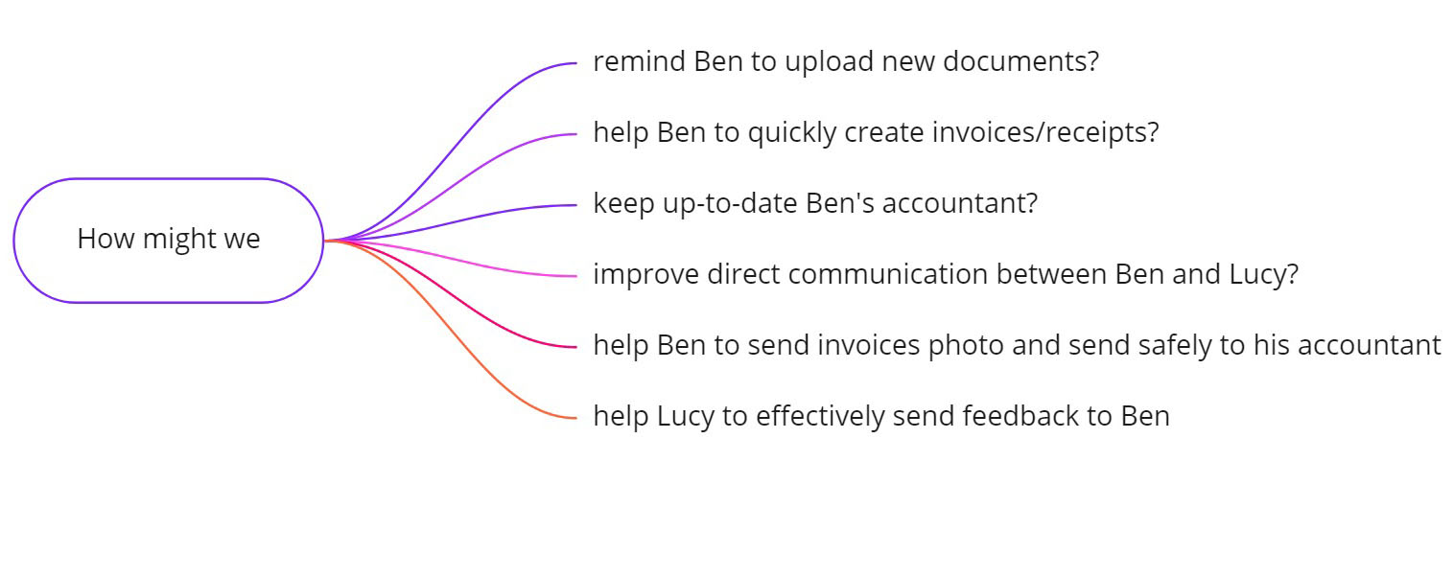
Brainstorming ideas
“How might we” technique from IDEO

Slide 5
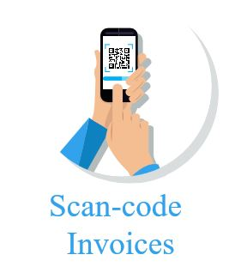
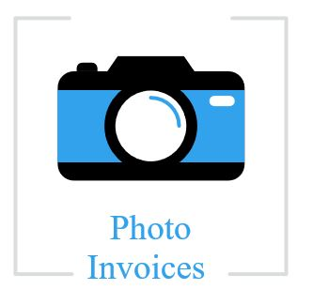
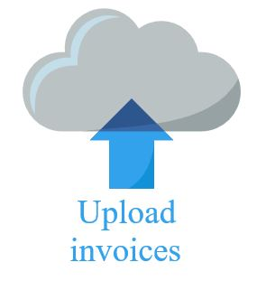
A Hypothesis
"The inductive approach for best User Experience design"
" I believe adding the “Scan QR code” button will be a useful feature for busy users who can scan, take photo or upload their documents and share them via cloud with their accountants, it will save their time.
This will increase and facilitate the collaboration of our users (Ben and Lucy) "

Slide 6
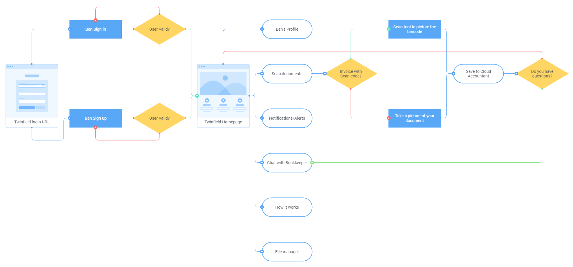
User Flow
"Architecture Design"
Entry point: Twinfield Login URL
Successful story: Ben quickly scans his invoice and shares with his accountant

Slide 7
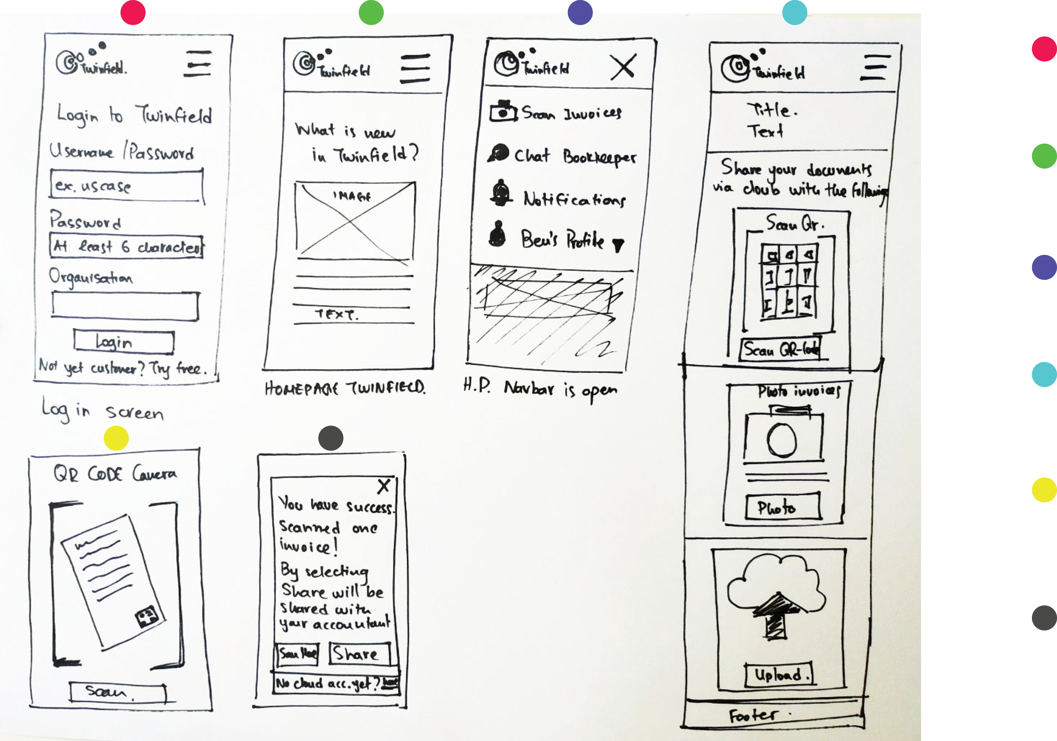
Ideate
"Low Fidelity Wireframes"
During this phase I started sketching out to be able to quickly see which idea would work best, using mobile first approach.
Ben logins to his profile
He is at the Homepage
He selects the feature Scan invoices
He selects to scan his invoice with the QR-code
He scans with his mobile camera
He successfully scanned and shared his invoice via Cloud to his accountant

Slide 8
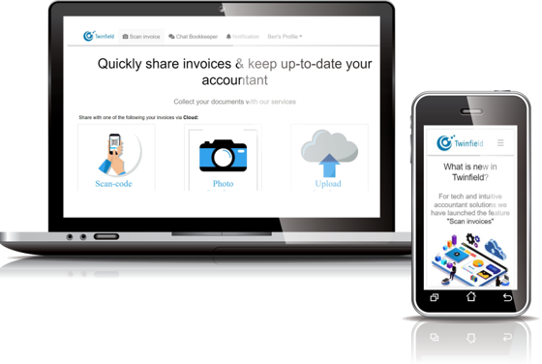
Visual – Frontend Prototype
"Interactive Prototypes by using HTML, CSS, JS"
Creating a prototype with frontend design allows a wider range of freedom in terms of design choices and time saving.
View prototype

Slide 9
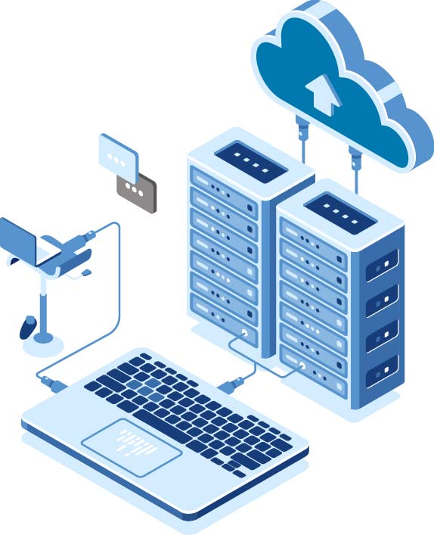
Future Steps
"Iterations of Usability testing & Improvements of the Prototype "
The next steps for this task is to conduct iterations of Usability testing
Improvements of the prototypes will follow based on our user’s feedback.

